Slide 1
Weakly-Supervised Semantic Segmentation Network with Deep Seeded Region Growing
Zilong Huang , Xinggang Wang, Jiasi Wang, Wenyu Liu, Jingdong Wang
www.xinggangw.info
Huazhong University of Science and Technology
Notes:
大家好，今天我给大家介绍的是我们发表在CVPR2017的工作Multiple Instance Detection Network with Online Instance Classifier Refinement

Slide 2
Weakly-supervised visual learning (WSVL)
Weakly-supervised visual learning is a new trend in CVPR
Search keyword “weakly supervised” and “weakly-supervised” in CVPR 17&18
Keyword | Weakly supervised | Weakly-supervised | In total
cvpr17 | 14 | 5 | 19/783
cvpr18 | 19 | 10 | 29/979

Slide 3
Weakly supervised semantic segmentation
The task of WSSS
WSSS overcomes the deficiency problem in semantic segmentation labelling.

Slide 4
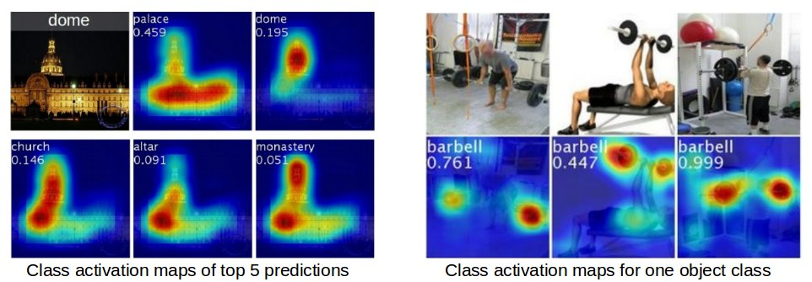
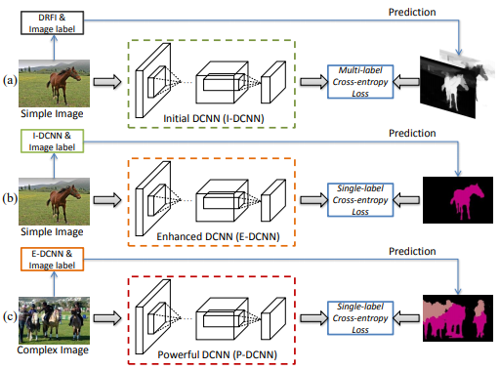
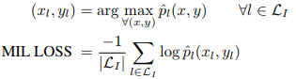
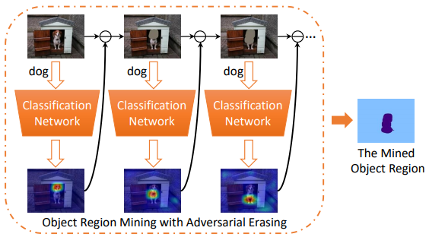
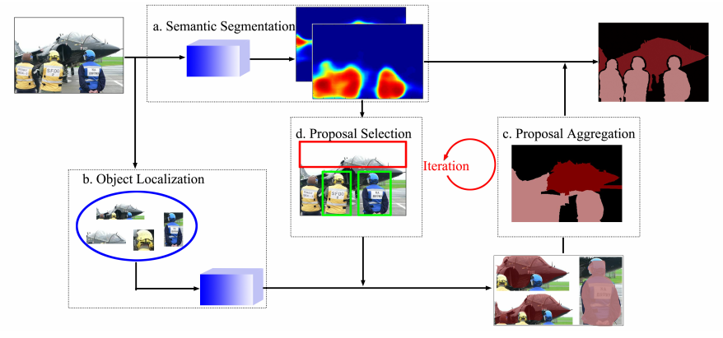
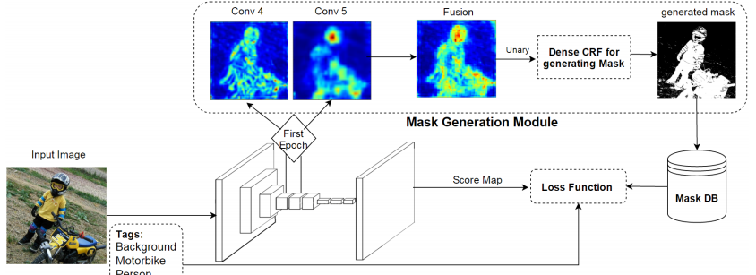
The development of WSSS
MIL-FCN, Pathak et al,
Arxiv 14, ICLRW 15
CAM, Zhou et al, CVPR 16
STC, Wei et al, TPAMI 15
Proposal classification,
Qi et al, ECCV 16
Built-in FG/BG Model
Saleh et al, ECCV 16
Adversarial erasing, Wei et al, CVPR 17
Figures are from the original papers

Slide 5
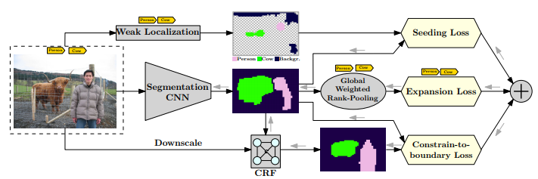
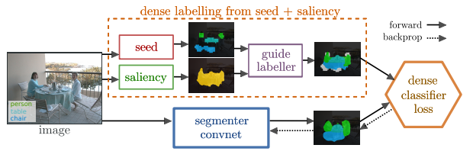
The development of WSSS
Seeding loss, Kolesnikov et al, ECCV 17
Saliency guided labler, Oh et al, CVPR 17
Multi-instance learning
Saliency guided
Built-in network information
Adversarial learning
Seeding loss
Figures are from the original papers

Slide 6
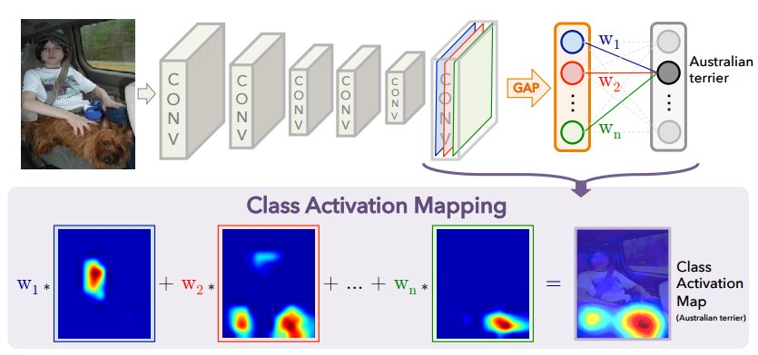
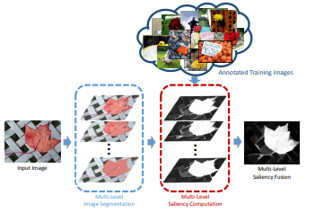
The basic framework in our paper
Step 1：Foreground seeds from CAM
Step 2：Background seeds derived salient region detection [Jiang et al, CVPR13]
Figures are from the original papers

Slide 7
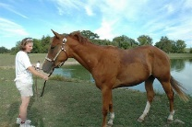


The basic framework in our paper
Step 3：FCN with seeding loss
FCN
Step 4：Retrain with FCN
FCN

Slide 8
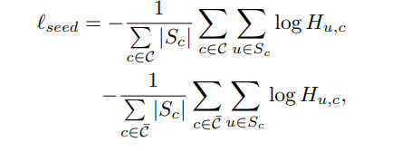
A small trick: balanced seeding loss
Balance the weights between foreground and background

Slide 9
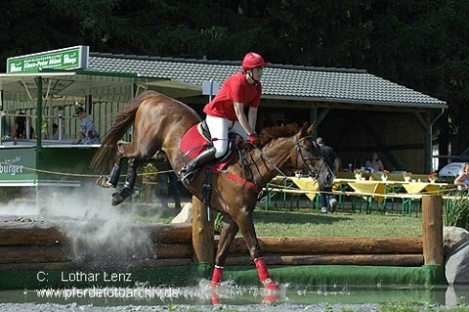
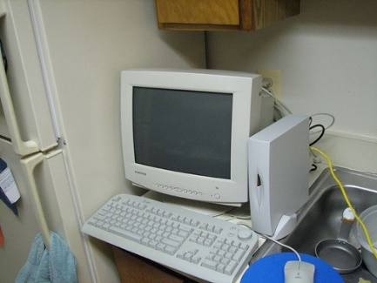
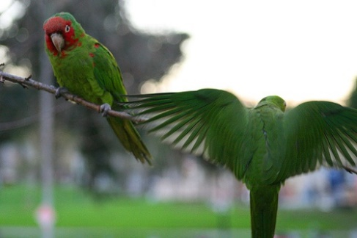






However, the seeds are sparse
Image
In practice, to retain the precision of seeds, there are about 40% pixels have labels.
Seeds
GT

Slide 10
How to improve the quality and quantity of seeds
Better “CAM” network
Saliency guidance
Adversarial erasing
…
Online seeded region growing

Slide 11


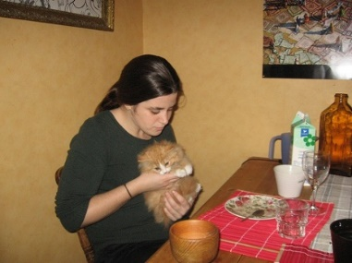
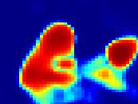
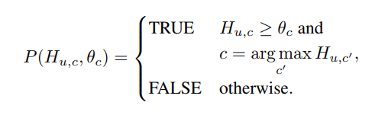

Deep seeded region growing
seeded region growing
Classification
network
Seed
Seed
Segmentation
Network
Seeding Loss
Downscale
Boundary Loss
CRF
Region growing criteria:
Directly use deep prob features
Cheap to compute
Online supervision updating
Progressively check the neighborhood pixels

Slide 12
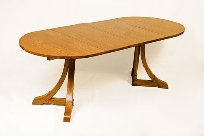

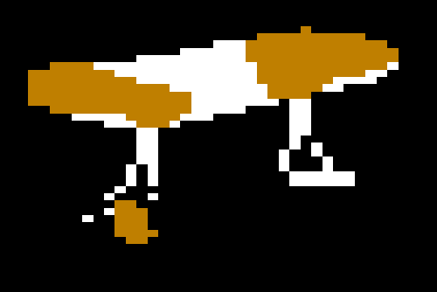


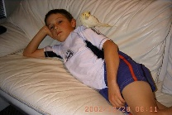










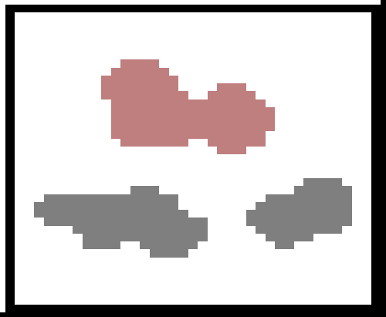
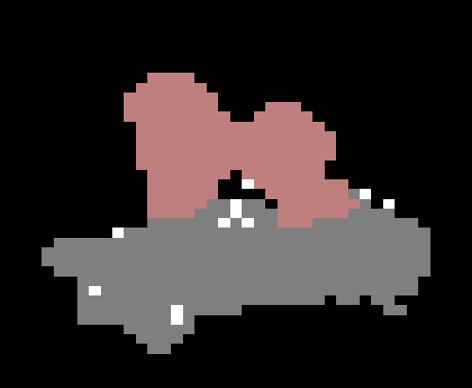
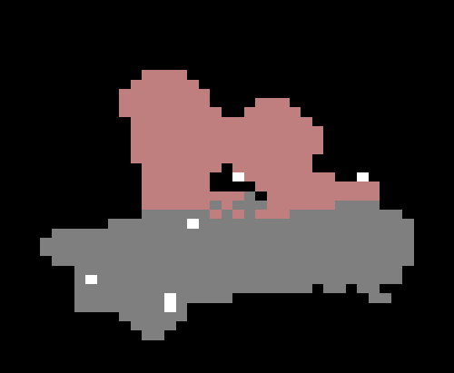
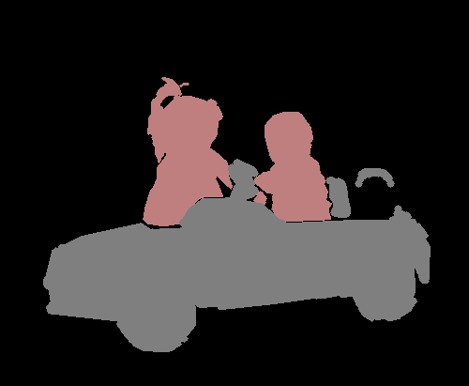


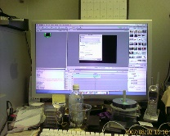




Deep seeded region growing
Training Image
Seed Cues
Epoch #1
Epoch #12
Ground Truth

Slide 13
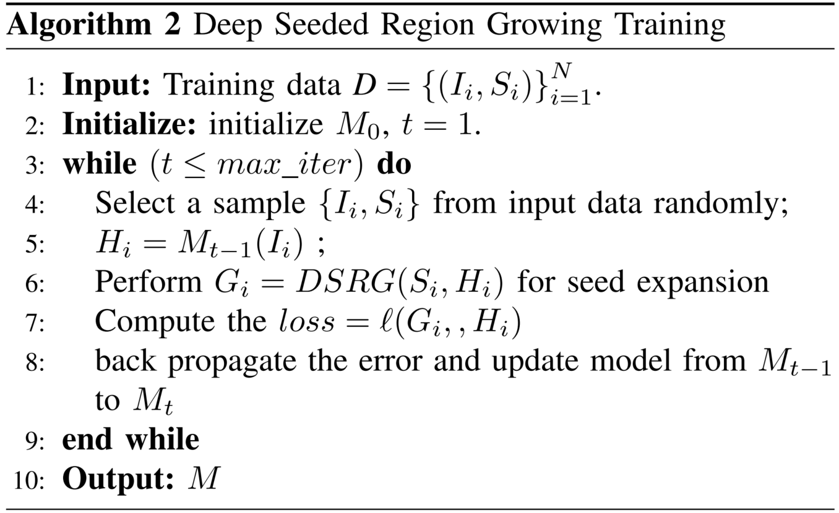
Deep seeded region growing

Slide 14
Experiments
Datasets
PASCAL VOC 2012, 10582 train, 1449 val, 1456 test
COCO, 80k train, 40 val
mIoU criterion
Classification network: VGG-16
Segmentation network: DeepLab-ASPP

Slide 15
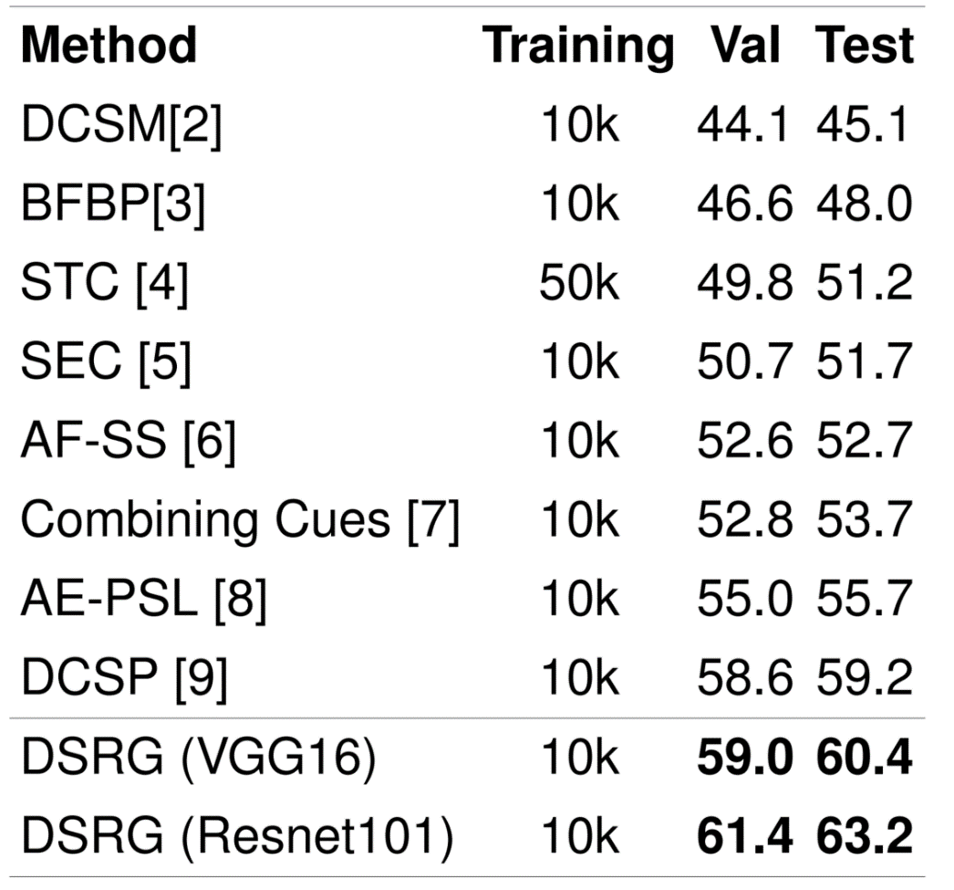
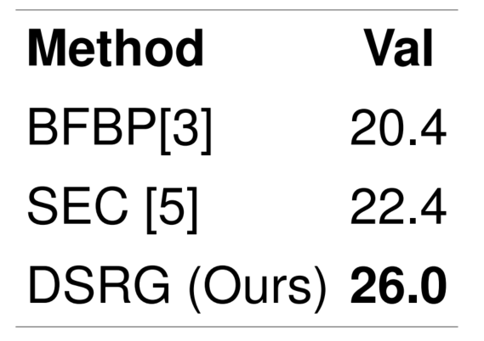
Main Results
PASCAL VOC
COCO

Slide 16
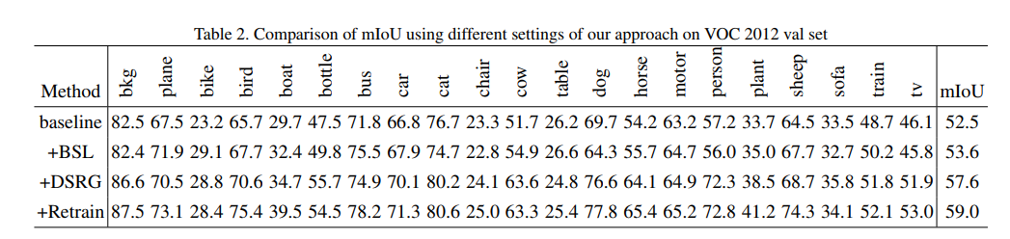
Ablation studies
The contributions of Balanced seeding loss, DSRG & Retrain

Slide 17

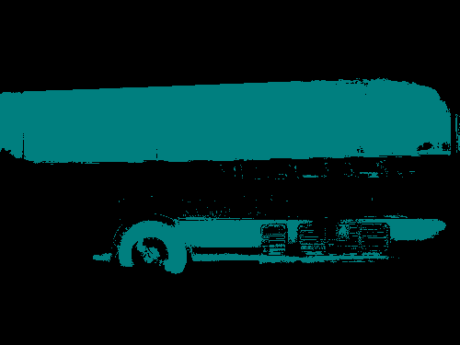


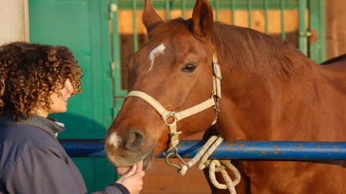



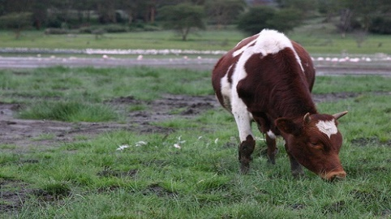



Ablation studies
Image
w/o DSRG
+DSRG
Ground Truth

Slide 18
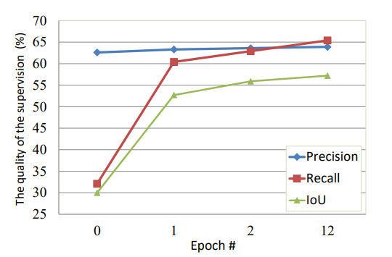
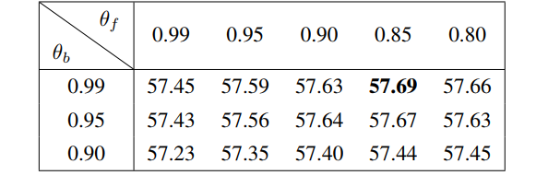
Ablation studies
The quality of the dynamic supervision (%)
with respect to the epochs.
Performance on PASCAL val dataset
for different θ

Slide 19
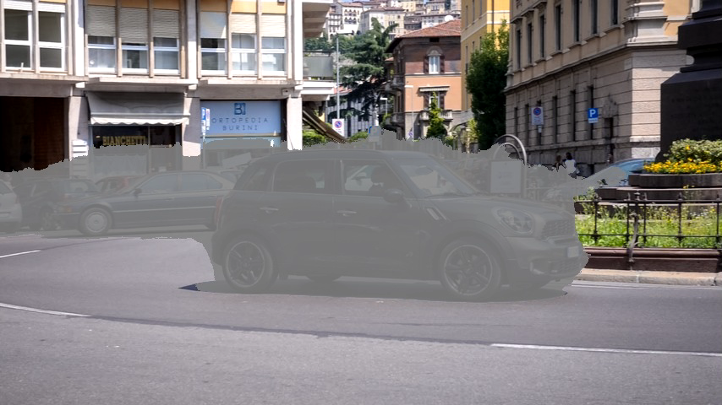
Video demo

Slide 20
Discussion
How to interpret DSRG
A Neural network generates new label by itself.
The inner structure of image/video helps, e.g., [Ahn & Kwak, CVPR 18].
From the perspective of SSL, pseudo label/supervision [Lee, ICMLw 13, Wang et al, MM 16] works.

Slide 21
Discussion
Current limitations of WSSS
Hard to obtain precise boundaries
Does not work well in complex dataset, e.g., COCO & Kitti
Let deep networks know what is an object, e.g., unsupervised learning from video.
Weakly and semi-supervised (WASS) visual learning.

Slide 22
The paper is available at http://www.xinggangw.info/pubs/cvpr18-dsrg.pdf
Codes will be available at https://github.com/speedinghzl/DSRG
Notes:
我们的论文已经放在arxiv上了。
Code也已经release在github上了。
欢迎大家关注。

Slide 23
Thanks for your attention!
Notes:
最后谢谢大家

